Slide 1
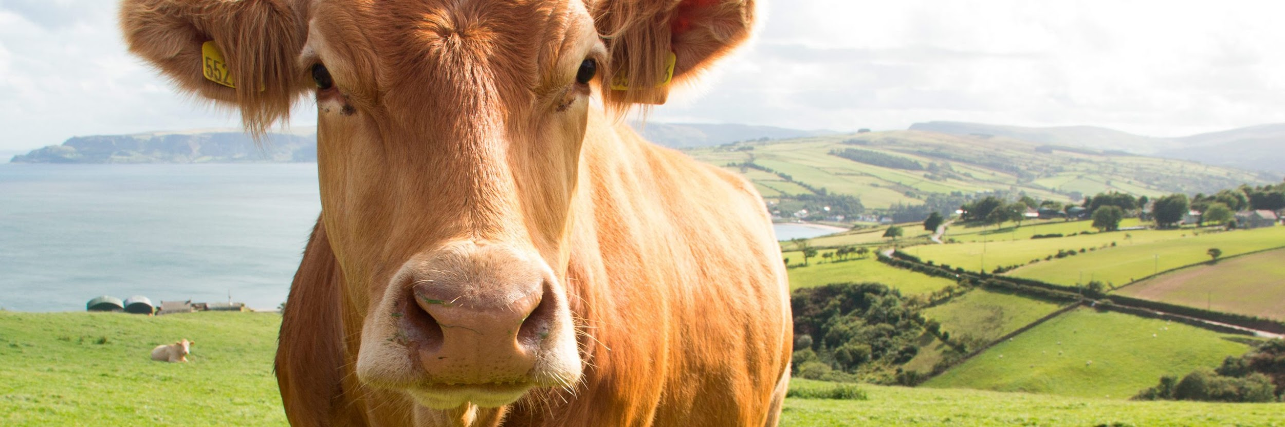

IMAGE COMPRESSION ALGORITHMS FOR PROCESS OPTIMIZATION IN LIVESTOCK FARMING
PRECISION

Slide 2

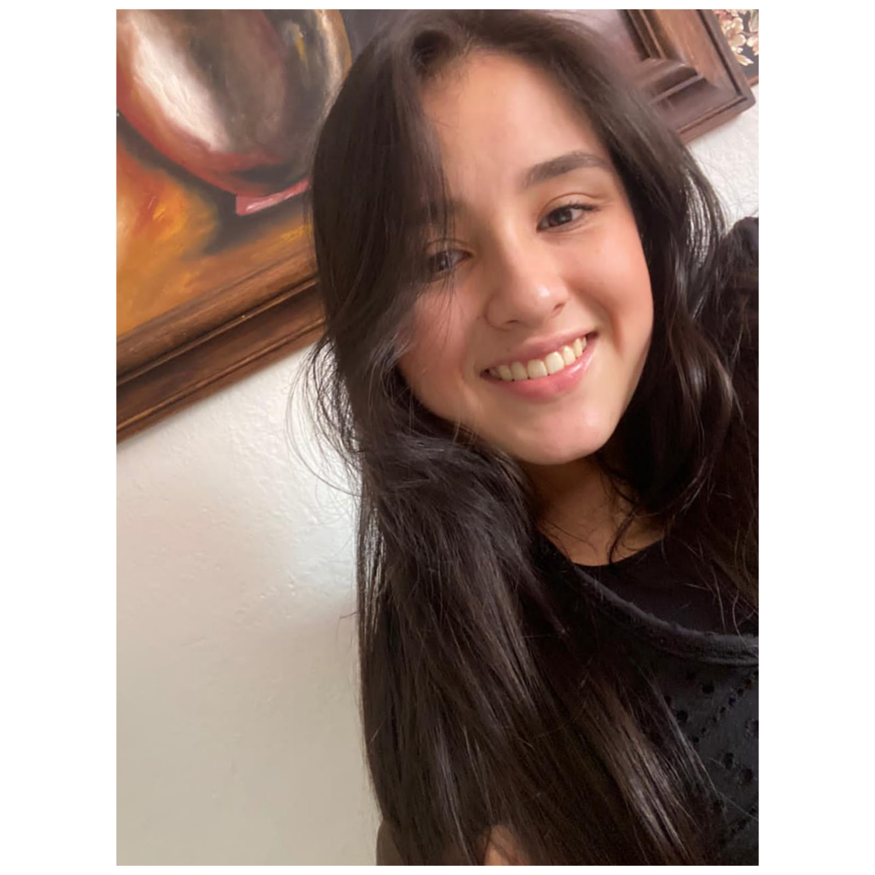
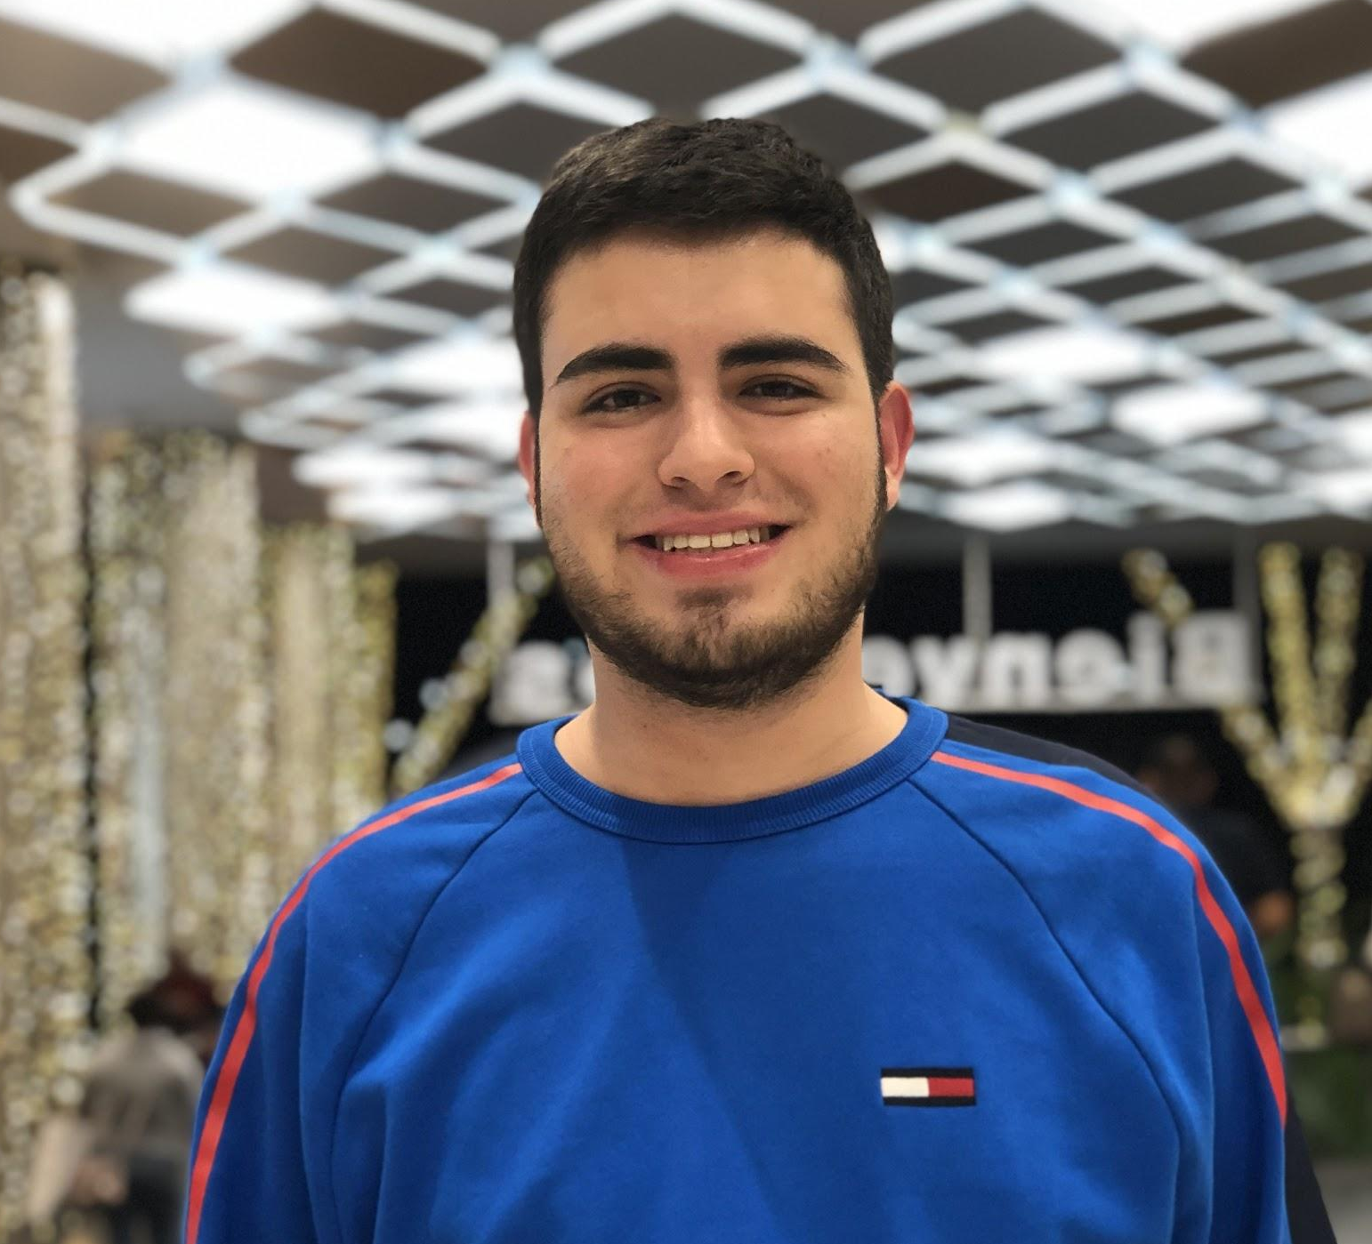
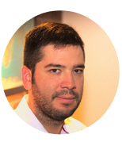
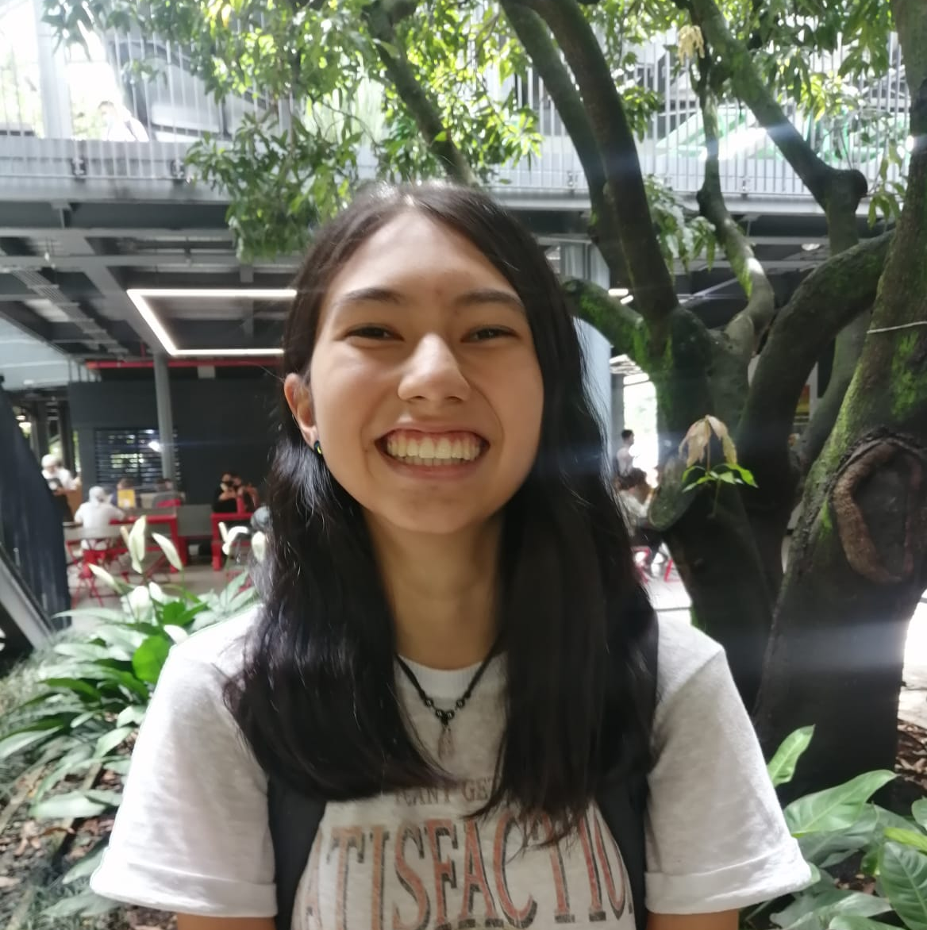

Team presentation
Stefanny Escobar Ramírez
Sara Gallego
David González
Simón Marín
Mauricio
Toro
https://github.com/StefannyEscobar/FarmingProject.git

Slide 3
Thanks!.
Supported by
The two author is supported by a Sapiencia grant funded by the municipality of Medellín. The other author are supported by Generation E. All authors would like to thank the Vicerrectoría de Descubrimiento y Creación, Universidad EAFIT, for their support in this research.

